Slide 1

Menstrual Equity in Public Higher Education
Sara Darwish
North Carolina State University

Slide 2

Menstrual equity IS a global issue
Global, meaning it is also an issue here in the United States.
“This is an issue that has received an increasing amount of attention, particularly in developing countries. But when we looked at what was known and documented in more developed countries like the United States, there wasn’t much.”
Anne Sebert Kuhlmann
Notes:
79% of menstruating people ages 18-54 in the United States have had to use makeshift sanitary items due lack of access to proper menstrual hygiene.

Slide 3
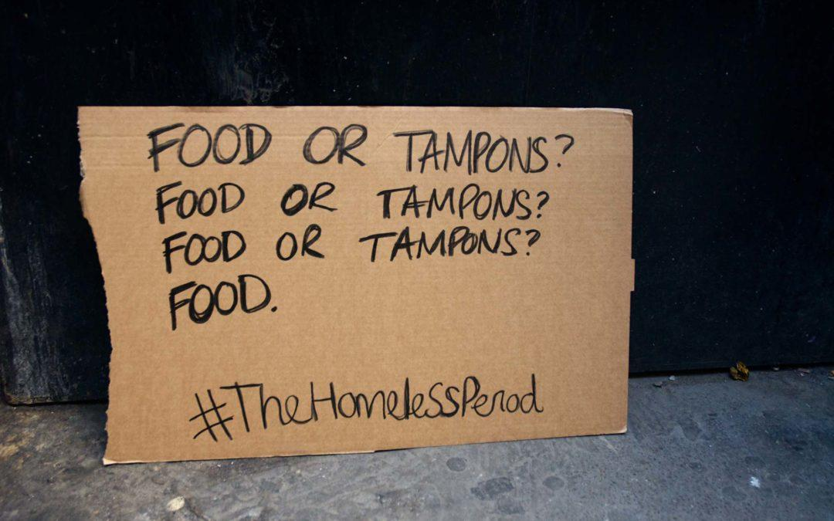
Menstrual Equity Does Not Exist, Period
Meaning…
Women and young women often lack equal or easily accessible access to menstrual hygiene products, whether due to affordability, stigma, availability, or other barriers.
High negative impacts in other areas of life for women, especially education.
Education is directly linked to other socioeconomic and social determinant factors, an example is poverty and food insecurity.
Notes:
79% of menstruating people ages 18-54 in the United States have had to use makeshift sanitary items due lack of access to proper menstrual hygiene.

Slide 4

Methods
This research sought to asses college students’ access to menstrual hygiene products and how being a menstruating person affects their educational experience.
Online Survey with Female Students (n = 140)
Eligible students were (1) at least 18 years or older, and (2) a female menstruating student at NC State.
In-depth Interviews with NC State Campus Stakeholders (n = 2)
Two current NC State students who created campus organizations that aim to tackle the issue of menstrual inequity.

Slide 5
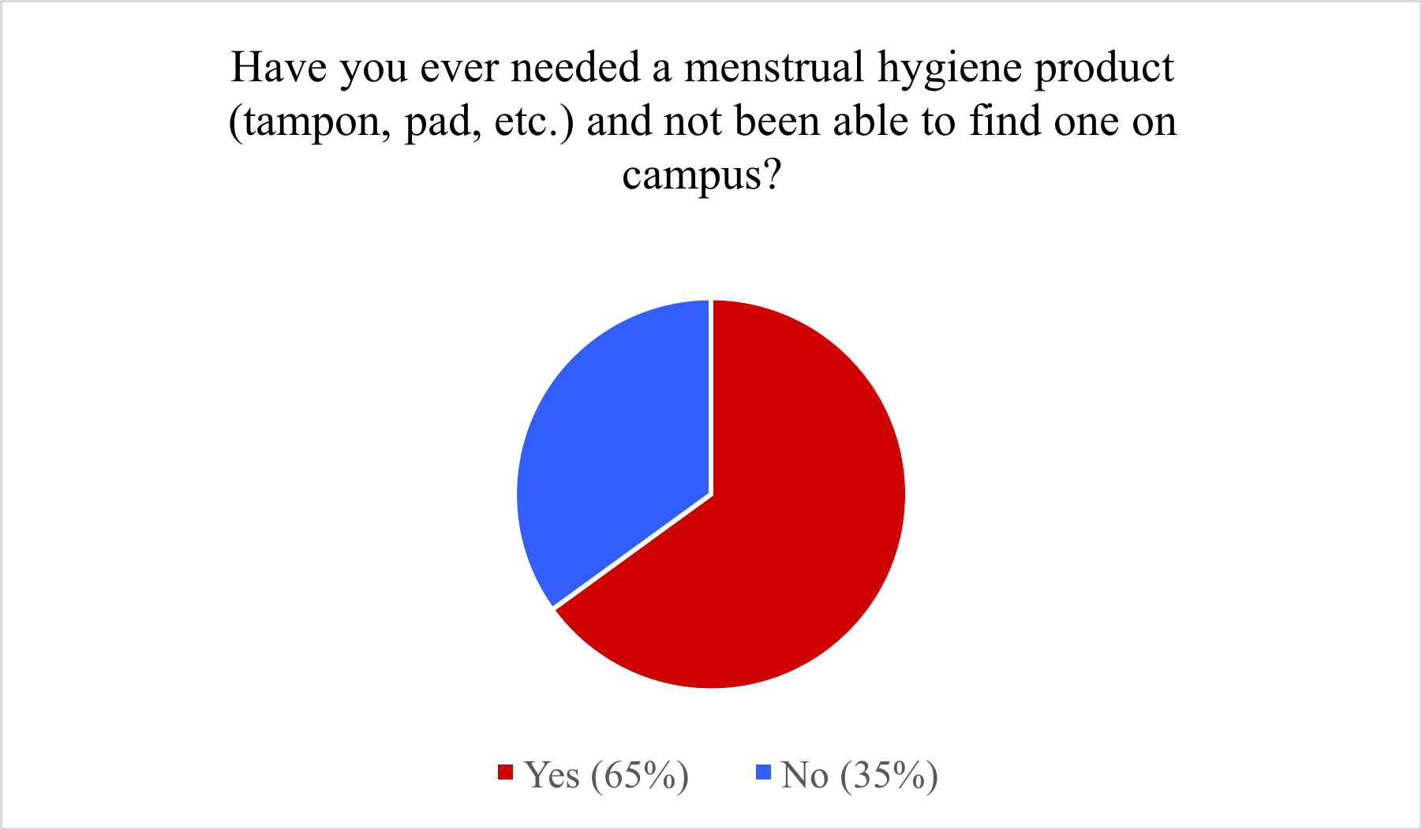
Have you ever needed a menstrual hygiene product (tampon, pad, etc.) and not been able to find one on campus?
Findings: Online Survey Results

Slide 6
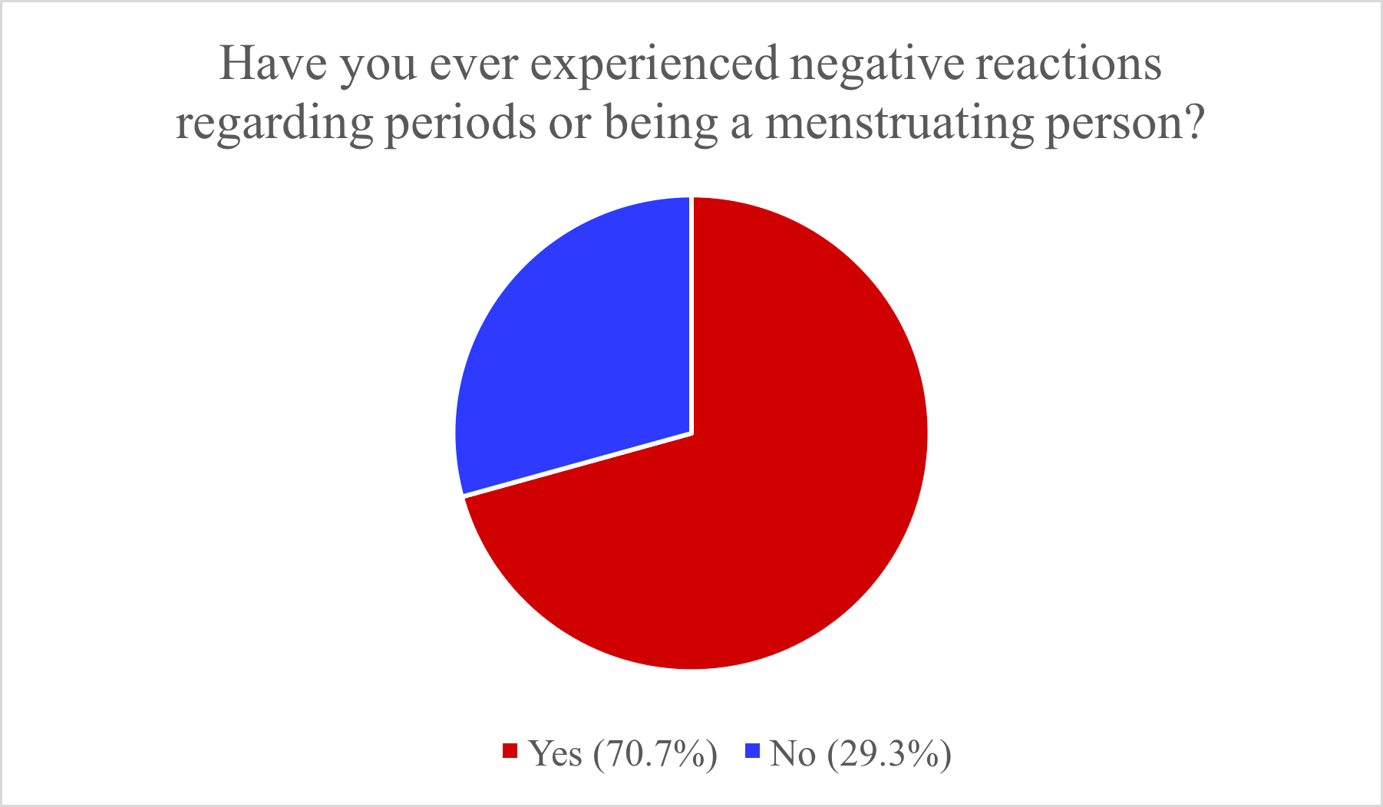
Have you ever received negative reactions regarding periods or being a menstruating person?
Findings: Online Survey Results

Slide 7
Findings: In-depth Interviews
Top 3 Themes:
Stigma as a Barrier to Access
Lack of Importance of Menstrual Access on Campus
Lack of Access and Availability
“There’s a lot of shame about our vaginas, there’s a lot of shame about periods, there’s a lot of shame around all of that, and I think it’s to suppress us. Th e more we talk about it the more we start to remove that suppression.”

Slide 8
Recommendations
Provide free or reduced-cost menstrual products in campus bathrooms
Conduct institutionally-endorsed education programs regarding menstruation, and women’s health generally.
More quantitative and qualitative research to further understanding of barriers to menstrual equity.
Adopt legislation to eliminate North Carolina’s statewide tax of 4.75% from the cost of menstrual products.

Slide 9
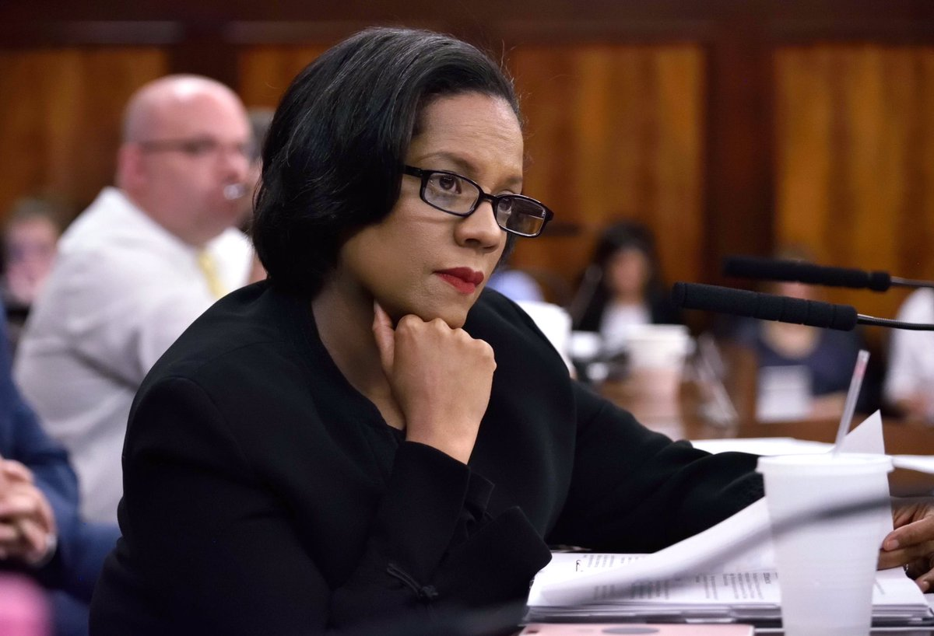
“The minute you have to ask someone for something that you need for your normal bodily function, you're creating a barrier.”⁶
New York City Councilwoman Julissa Ferreras-Copeland
Notes:
79% of menstruating people ages 18-54 in the United States have had to use makeshift sanitary items due lack of access to proper menstrual hygiene.

