Slide 1
The Shift Towards Sustainability:
Addressing Poverty Through a Mobility Program for Women of Color and Their Children
Leah Ford
University of North Carolina at Chapel Hill, 2016 CSW Fellow
Notes:
our environment encompassses the air we breathe, the ground we walk on, the oceans we swim in, and the trees outside. it’s also the communities we live in, the schools we go to and our social networks. our environment has the ability to affect all aspects of our lives.

Slide 2

What is our environment?

Slide 3
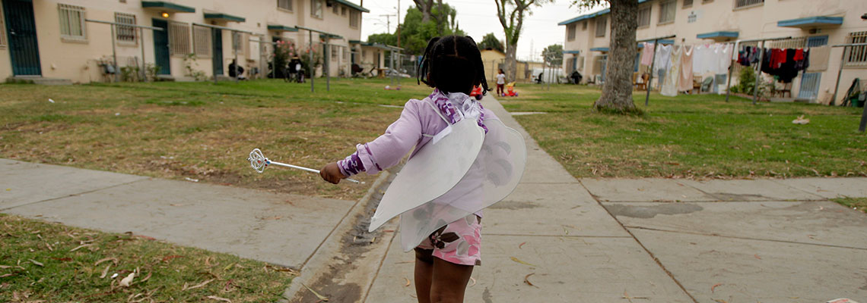
Statement of the Problem
Lack of Resources → Disadvantaged Communities → Poor health and well-being outcomes
Notes:
Disadvantaged communities in urban North Carolina tend to be more affected by concentrated poverty and a history of racial residential segregation
These factors have lead to a lack of economic resources and municipal support.
As a result, the health and wellbeing of women of color and their children, who are disproportionately represented in these areas, is negatively affected
environment has been proven time and time again to affect health
after lots of research and exploring of policy solutions that could work in North Carolina, I found that a housing mobility program is a viable solution that could result in more sustainable communities in north carolina

Slide 4
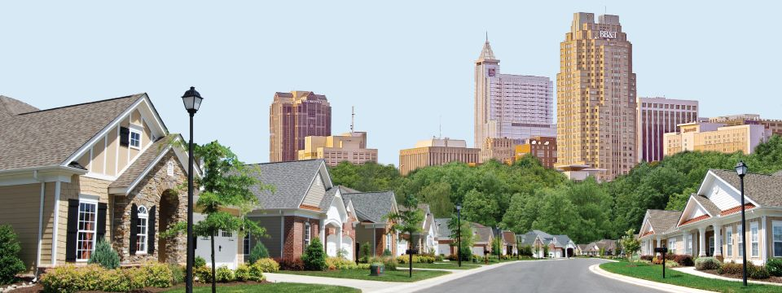
Past: Poverty and Segregation
Raleigh, North Carolina
Notes:
Racial residential segregation is a manifestation of racism
Historically, residential segregation was a system used politically and socially to keep black and white communities and people separate -- through the creation of unfair policy, etc.
Black communities have historically been under resourced
Segregation consequently created conditions that were harmful to health in social and physical environments
affecting access to education and employment opportunities
Despite desegregation, such patterns still exist and are actively affecting the daily lives of people in urban north carolina

Slide 5
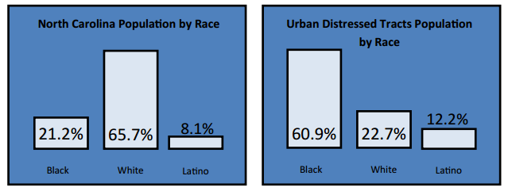
Past: Its Effects
Notes:
racial residential segregation is real and has lasting effects
A population breakdown shows that while more than half of North Carolina’s population is white, black people dominate North Carolina’s urban distressed tracts
Urban distressed tract: concentrated poverty
unemployment 50% greater than North Carolina’s unemployment rate of 9.7%
annual per capita income ⅓ lower than North Carolina's per capita income of 25,256
poverty rate of 50 percent greater than North Carolina’s poverty rate

Slide 6
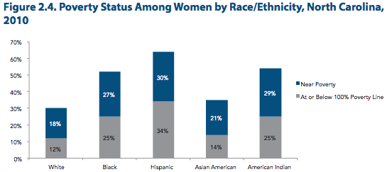
Notes:
a breakdown of women in north carolina by race shows that all women of color experience rates of poverty higher than those of their white counterparts
with hispanic women experiencing the highest rates in poverty

Slide 7
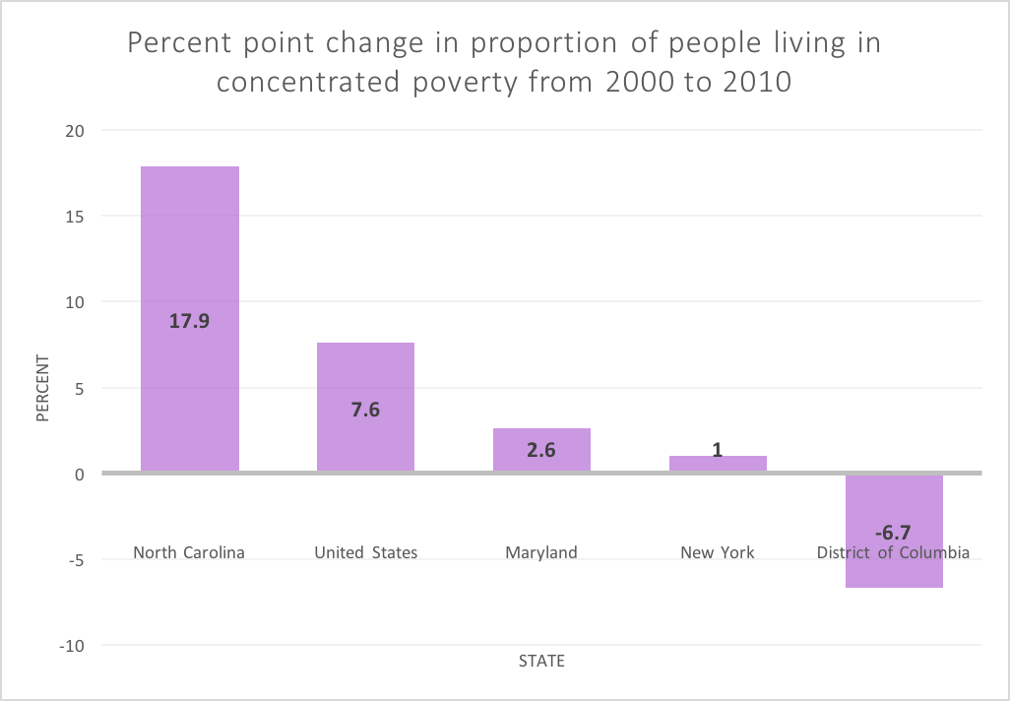
Present: The Issue at Hand
Notes:
Currently, 18 percent of North Carolinians live in poverty and North Carolina has the 12th highest poverty rate in the country
Over a 10 year period, from 2000 to 2010, North Carolina had seen the highest growth in number of people living in poverty, with rates close to 20 percent
it’s the highest rate in the country, beating the average set for the united states
The consistent rise in poverty is affecting neighborhood conditions and resource availability, causing negative effects on health and wellbeing

Slide 8



Present: The Issue at Hand
Notes:
countless studies conducted in north carolina have documented health and birth disparities across race. racial residential segregation has resulted in long term disparities in health, affecting women and their children
in wake and durham county, north carolina it was found that differential neighborhood environments can lead to preterm birth
in chicago it was found that community characteristics associated with concentrated poverty patterns were significant predictors of low birth weight
an additional study done in chicago found links between african american mothers perception of their environment and stress levels and very low birth weight

Slide 9


Future: Passage Home
Notes:
it was through lots of research and collaborations with my partner organization, Passage Home, that led me to an attainable solution: a housing mobility program for the state of north carolina
the goal of the program is to move families to self-sufficiency, while reducing the number of people in poverty
Passage Home offers long-term assistance to clients with similar goals of breaking the cycle of poverty for communities in Wake County, North Carolina by connecting families and neighborhoods to resources and opportunities
they assist clients in a variety of ways:
providing them with job assistance, housing, and GED classes,
they also have a youth program, which is an after school program for children of clients that provides a van to pick up children after school, tutors and help with homeworks and a free meal each night.
passage home connects their clients with resources and opportunities not otherwise offered to them, the housing mobility program will encompass similar things

Slide 10
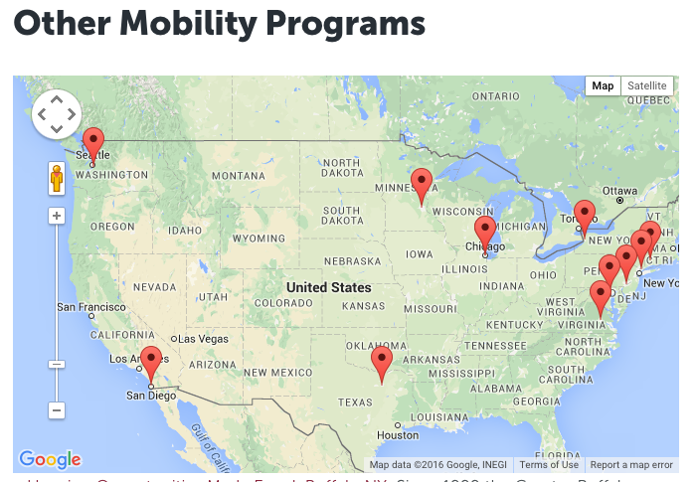
Future: Towards Sustainability and Self-Sufficiency
Notes:
(the housing mobility program) it will be an extension on the existing Housing Choice Voucher program
the program will provide vouchers to families who qualify, allowing them to move into higher-opportunity communities
the program will include:
counseling, tenant education, budget and credit advice, housing search assistance, and referrals to other service providers including energy assistance, food banks, security deposit resources, credit counseling, furniture resources and legal services
the program will also include workshops about home maintenance, financial management, healthcare, schools and education and how to be active participants in their new community
this program is based off a 10 year housing demonstration called moving to opportunity put on by the us department of housing and urban development
the demonstration proved that housing mobility can result in better health and mental health outcomes
such mobility programs have been implemented in states around the country, including programs in san diego, california, chicago and baltimore maryland. it’s time for other states to consider mobility programs as a solution to environmentally caused health issues. it’s time for housing mobility to serve the citizens of north carolina

Slide 11
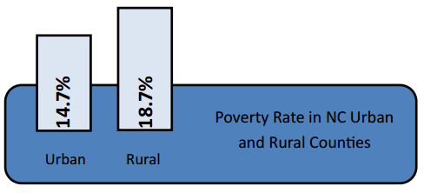
Policy Shortcomings
Notes:
rural communities experience poverty too
it is true and it’s an issue that must be addressed as well. but the rates of concentrated poverty in addition to the prevalence of distressed tracts in urban areas, led me to focus my research on urban areas of north carolina
a study done for _____ found that while rural areas have higher rates of poverty in north carolina, urban distressed tracts experience poverty at a rate that is 10% greater than rural areas

Slide 12
Conclusion/Call to Action
We have a responsibility
Notes:
women and their children deserve adequate resources and opportunity
they deserve to know there are people out there supporting them and wanting them to them to succeed
poverty and low-income communities will persist to exist but the goal is to bring north carolina a step closer to developing sustainably
they can do that by advocating for justice for women of color in disadvantaged communities
to improve their health, to improve the lives of their little ones, to promote overall positive well-being

Slide 13
Citations
Slide two:
http://www.urban.org/urban-wire/risks-girls-disadvantaged-communities-face-and-how-keep-them-safer
Slide three:
http://www.popularraleighneighborhoods.com/blog/
http://www.eagleih.com/SiteAssets/environmental/environmental.jpg
Slide four:
Center for Urban and Regional Studies, 2013
Slide six
U.S. Census Bureau, 2013
Slide seven
U.S. Census Bureau
Slide eight
ERproductions Ltd/Blend Images/Corbis
FRED DUFOUR/AFP/Getty Images
https://nbclatino.files.wordpress.com/2012/02/preterm.jpg?w=290&h=400&crop=1
Slide nine
http://www.nber.org/mtopublic/
Slide ten
Center for Urban and Regional Studies, 2013

